Slide 1

The Machine Learning Process
How do I work with date and time
in pandas?
Dr. Reza Dibaj

Slide 2
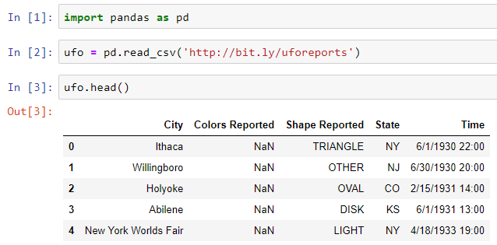
Working with date and time
Let’s pull up a dataset for today….
Notes:
import pandas as pd
ufo = pd.read_csv('http://bit.ly/uforeports’)
ufo.head()

Slide 3
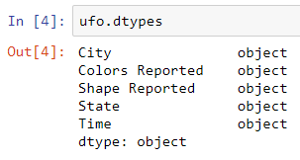
Working with date and time
What is the type of Time column in our DF?
Notes:
ufo.dtypes

Slide 4

Group Discussion
How can we extract the hour portion of the Time column?

Slide 5
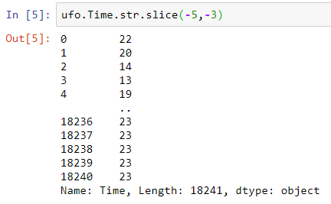
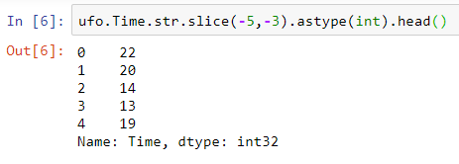
Working with date and time
One way is using programming trick, as follows:
And what if we want to do math on it?
Notes:
ufo.Time.str.slice(-5,-3)
ufo.Time.str.slice(-5,-3).astype(int).head()

Slide 6
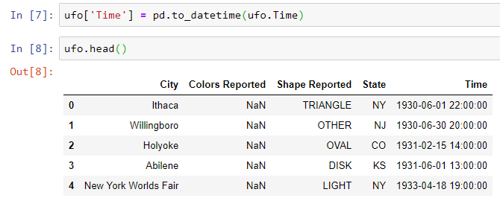
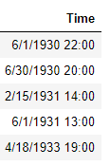
Working with date and time
The previous approach is not an efficient one at all.
What could we do instead?
A better methodology starts with converting “Time” column into pandas special Date and Time format. It understand which part is the day, month etc. by itself.
After
Before
Notes:
ufo['Time'] = pd.to_datetime(ufo.Time)

Slide 7
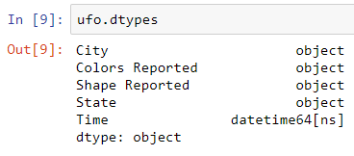
Working with date and time
Let’s look at the “Time” data type after the previous conversion:
Now, it is ready to work with this Series and apply some attributes.
Notes:
ufo.dtypes

Slide 8
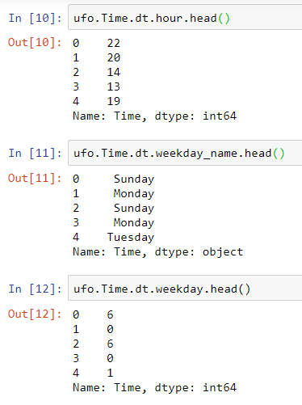
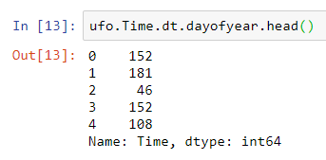
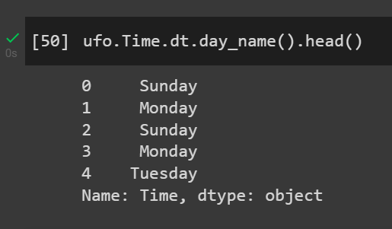
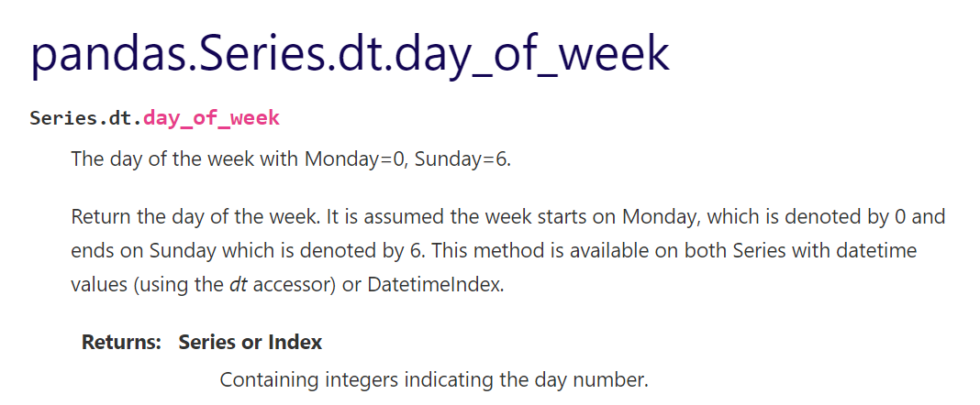
Working with date and time
Let’s look at the “Time” data type after the previous conversion:
Deprecated
Notes:
ufo.Time.dt.hour.head()
ufo.Time.dt.weekday_name.head()
ufo.Time.dt.day_name().head()
ufo.Time.dt.weekday.head()
ufo.Time.dt.dayofweek.head()
ufo.Time.dt.dayofyear.head()

Slide 9
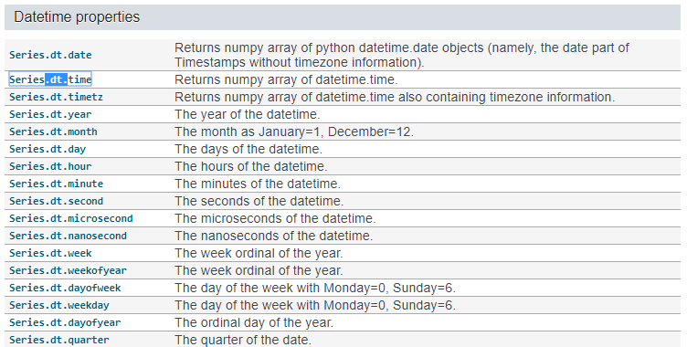
Working with date and time
For knowing more about these properties, we can go to the following path:
Google pandas Series→ Searching for “.dt.”
Click here!
Notes:
https://pandas.pydata.org/pandas-docs/stable/reference/series.html#time-series-related

Slide 10
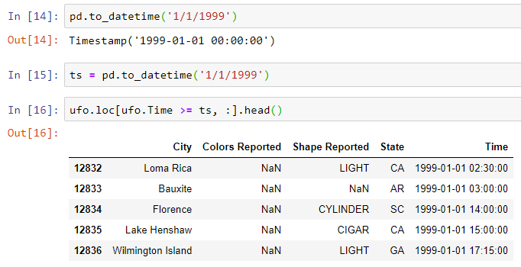
Working with date and time
Now we pass a string to to_datetime() method:
Notes:
pd.to_datetime('1/1/1999’)
ts = pd.to_datetime('1/1/1999’)
ufo.loc[ufo.Time >= ts, :].head()

Slide 11
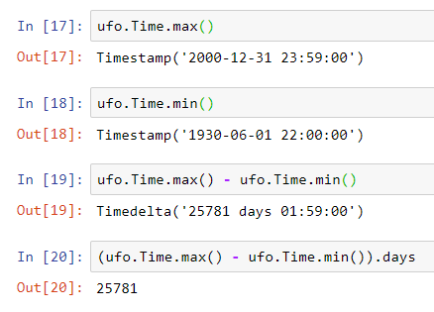
Working with date and time
Moreover, we can do mathematical operations on Date and Time format:
Notes:
ufo.Time.max()
ufo.Time.min()
ufo.Time.max() - ufo.Time.min()
(ufo.Time.max() - ufo.Time.min()).days

Slide 12

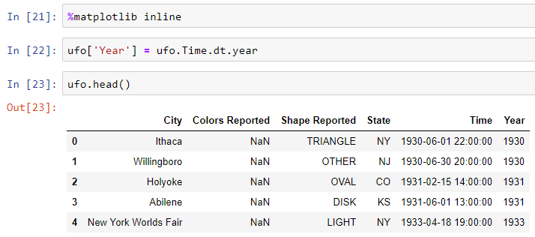
Bonus Tip
We are going to plot the number of UFO by year. For plotting that, let’s run the following commands:
Notes:
%matplotlib inline
ufo['Year'] = ufo.Time.dt.year
ufo.head()

Slide 13
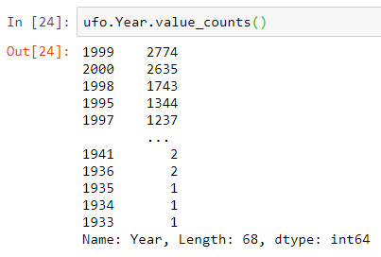
Bonus Tip
We use .value_counts() to see the number UFO per year, which is sorted based on the number of UFO in descending order.
Notes:
ufo.Year.value_counts()

Slide 14
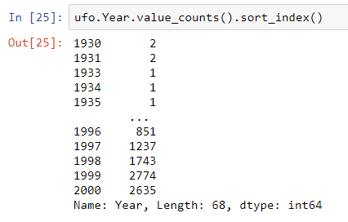
Bonus Tip
Let’s use the concept of index to sort the UFO’s number, based on the reported year as follows:
Notes:
ufo.Year.value_counts().sort_index()

Slide 15
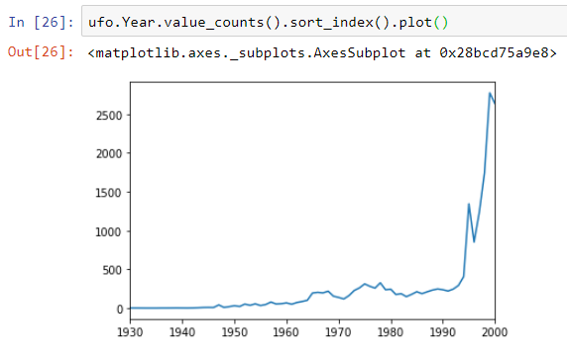
Bonus Tip
And the last step is to plot the previous result, as simple as this:
Notes:
ufo.Year.value_counts().sort_index().plot()

Slide 16

Thank you
Question?
To be
Not to be

